Slide 1
Predicting Success of Hyper-Casual Mobile Games
- Machine Learning A3, Student Id: 13132903

Slide 2

What is a Hyper-Casual Game ?
Simple
Tap to play
Infinitely Re-playable
Highly Addictive

Slide 3
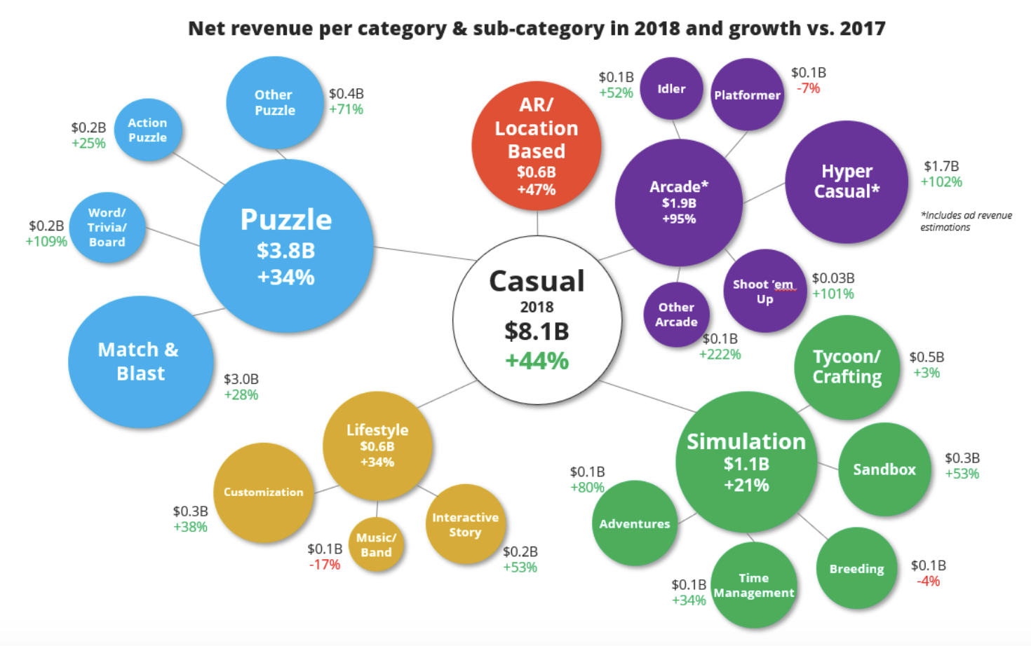
Why Should I Care ?
Hyper Casual category is fastest Growing with over 100% growth
It’s a $2.4 Billion Market this year
The games are simple and creating new users like 50+ age adults
The opportunity is calling, Goldman Sachs invested $200 Million in a Hyper-casual game maker in 2018

Slide 4

What are you suggesting ?
Create a tool to predict a game’s success in very early stage
Use this tool to discover game’s with high success potential
Invest in these games and make amazing returns on your investment.
Why do the Gamer’s developers need your Investment ?
$$ Marketing $$

Slide 5

How will you do It?
Collect User engagement data from various hyper casual games
Define a game’s success in terms of play store rank achieved or user lifetime value
Train a machine learning model on the date to predict the success of the games
Use the Model to predict success for new games

Slide 6
What do you need ?
Time: 1 Year
People: Business Analyst (2) x 7 months
Data Scientist (1) x 9 months
Software Engineer (1) x 1 month
Resources : TOTAL: AU $205,000
People cost: AU $175,000
Data Collection cost: AU $20,000
Hardware/ Ad-hoc cost: AU $10,000

Slide 7
Thank You !
Questions ?

